Slide 1



Slide 2

GST NEW RETURNS

Slide 3
LACUNAE IN THE EARLIER RETURNS
GSTR – 3B is based on manual inputs.
GSTR 2 & 3 not operational.
No link between GSTR 1 and GSTR 3 B, leading to scams.
Recipient cannot know return filed status of supplier.
Duplication in many places.
Same return format for all assesses.
Missing credit menace.
GSTR 2A is dynamic.

Slide 4
PRELUDE TO NEW RETURNS
Section 43 A enacted – not yet notified.
Rule 36 (4) introduced – Premature?
Other rules to be introduced.

Slide 5
Large taxpayers having aggregate turnover of more than Rs.5 Crores in preceding FY
Can file only
Normal return- RET 01 on monthly basis
All types of supplies- B2B, B2C, zero rated, deemed exports, supplies through e-com etc. Quarterly Normal in RET -01
Small taxpayers having an aggregate turnover up to Rs..5 Crores in preceding FY
Only B2C + RCM + B2B – SUGAM –
RET-03 (Quarterly)
Only B2C + RCM - SAHAJ – RET 02- (Quarterly)

Slide 6
Switching over from one type of return to another is allowed as tabulated below
From | To | Frequency
Quarterly/Monthly (Normal) | Monthly/Quarterly (Normal) | Once at time of filing first return. It cannot be changed during the FY. .
Quarterly (Normal) | Sahaj/Sugam | Once in a FY at the beginning of any quarter.
Sugam | Sahaj | Once in a FY at the beginning of any quarter.
Sahaj | Sugam/Quarterly (Normal) | More than once in a FY at beginning of any quarter.
Sugam | Quarterly (Normal) | More than once in a FY at beginning of any quarter.

Slide 7
Summary
S.No. | PARTICULARS | NORMAL |  | SAHAJ | SUGAM
 |  | Monthly | Quarterly
1 | Type of Returns | RET-01 | RET-01 | RET-02 | RET-03
2 | Periodicity of Filing | Monthly | Quarterly | Quarterly | Quarterly
3 | Periodicity of Payment of Tax | Monthly | Monthly | Monthly | Monthly
4 | Form used and Date of Payment of Tax | RET-01 (20th of Following Month) | PMT-08 (20th of Following Month) | PMT-08 (20th of Following Month) | PMT-08 (20th of Following Month)
5 | Date of Filing | 20th of Following Month | 25th of Following Month | 25th of Following Month | 25th of Following Month
6 | Aggregate Turnover (Preceding FY) | Above 5 Cr. (Mandatory) | Upto 5 Cr. (Optional) | Upto 5 Cr. (Optional) | Upto 5 Cr. (Optional)
7 | Nature of Supply | All Types of Supply | All types of Supply | B2C, RCM transactions | B2B, B2C, RCM
8 | Provisional ITC | Available | Available | Not Available | Not Available

Slide 8
CONSTITUENTS OF THE RETURN
NORMAL
ANX - 1
ANX - 2
SAHAJ
ANX - 1
SUGAM
ANX - 1
RET – 1
ANX – 1A
RET – 1A
ANX - 2
RET – 1
ANX – 1A
RET – 1A
ANX - 2
RET – 1
ANX – 1A
RET – 1A

Slide 9
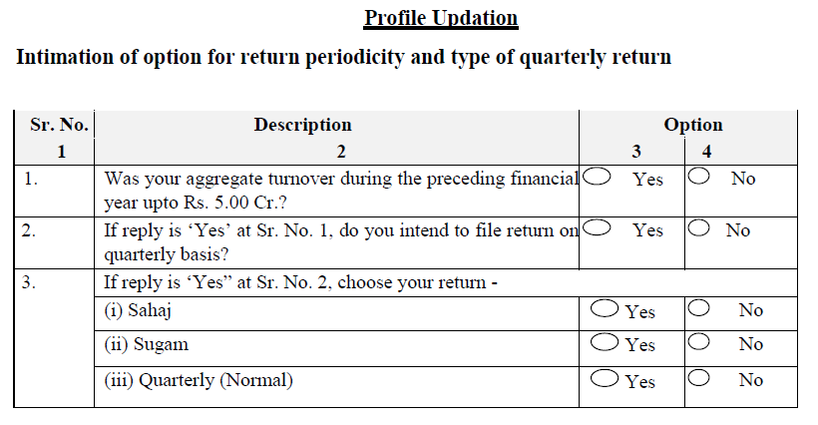

Slide 10
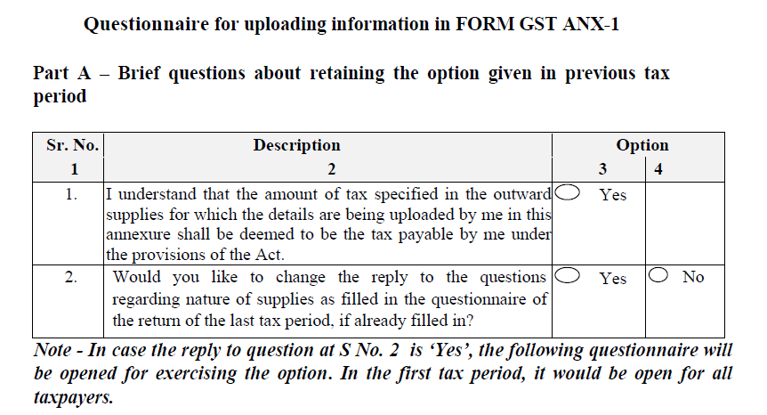

Slide 11
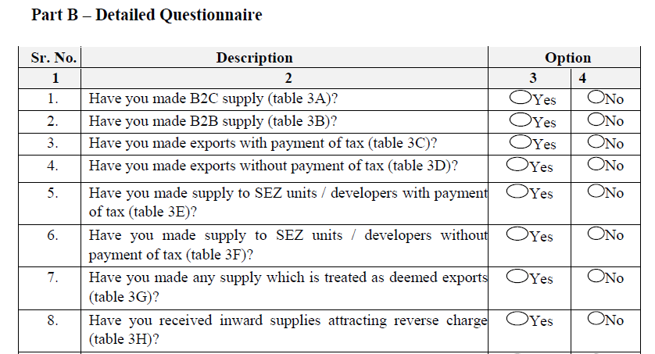

Slide 12
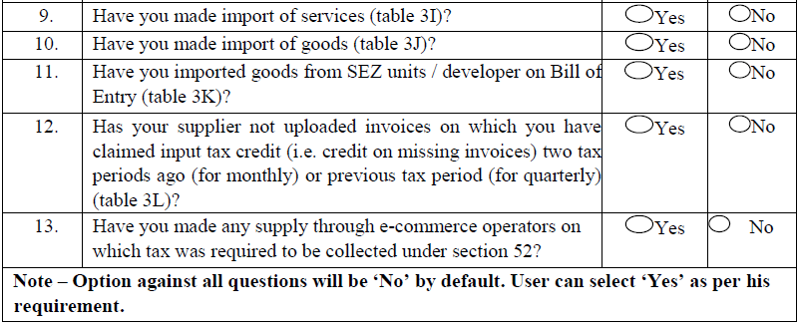

Slide 13
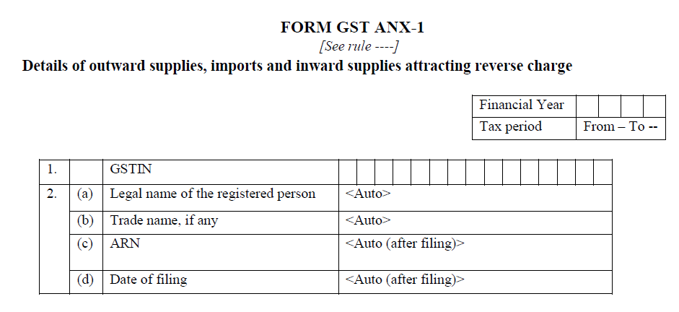

Slide 14
TABLE - 3
This creates the tax liability.
All transactions which leads to tax liability should be declared here.
No invoice-wise reporting of B2C.
HSN at 6 digit level for more than Rs.5 Crore assesses.
Import & SEZ, to be linked to icegate.

Slide 15
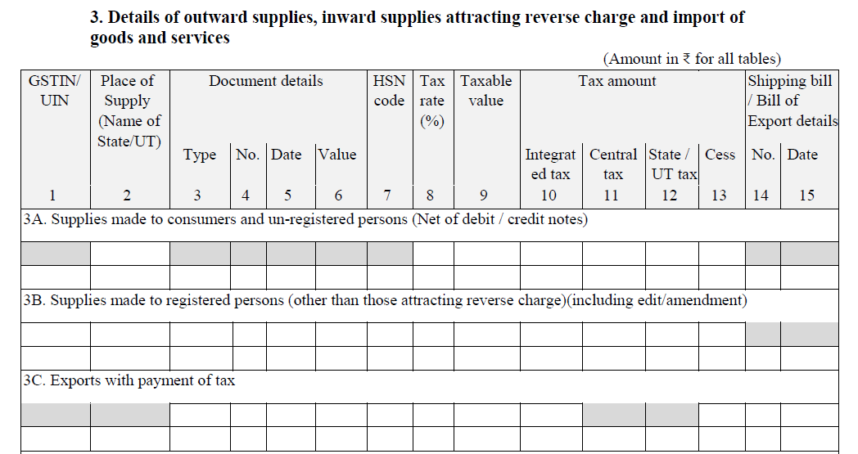

Slide 16
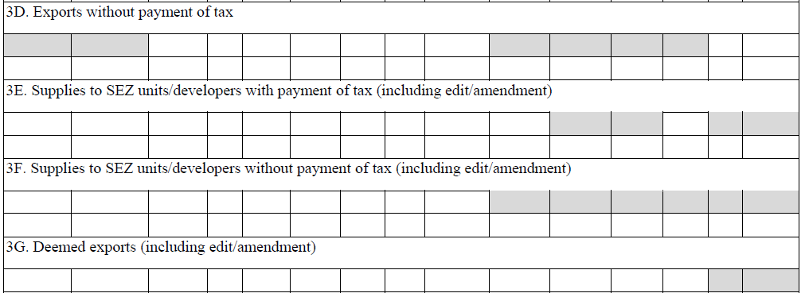

Slide 17
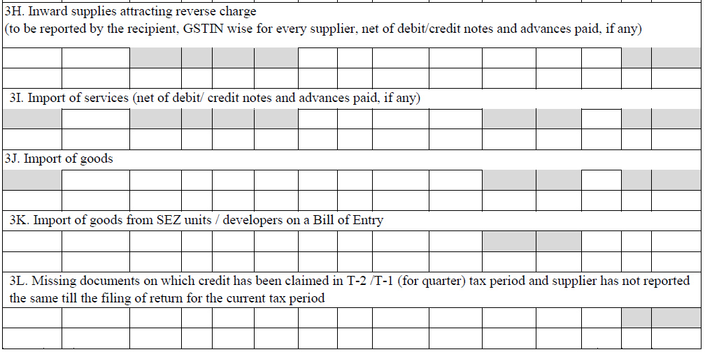

Slide 18
3L – Missing credits.
Credit for missing invoices can be taken upto 10 % of credits reflected in ANX-2.
Invoices in respect of which such credit is taken should be identified.
Credit taken in April, not uploaded by supplier (monthly) in April, May & June – to be declared in July return filed in Aug.
Credit taken in April, not uploaded by supplier (Quarterly) in Q 1 – to be declared in July return filed in Aug.

Slide 19
3L – Missing credits.
As and when declared by supplier and reflecting in ANX-2, such credit to be reversed, as credit already taken provisionally.
If the supplier is not at all filing his returns, is recipient liable to reverse such provisional credit availed?
Missing credit over and above 10 % has not at all been availed.
Cumulative method to be followed.

Slide 20
DETAILS | MONTH ON MONTH |  |  | CUMULATIVE
 | APRIL | MAY | JUNE | APRIL | MAY | JUNE
ITC AS PER ANX-2 | 100000 | 110000 | 50000 | 100000 | 210000 | 260000
ITC AS PER BOOKS | 150000 | 120000 | 40000 | 150000 | 270000 | 310000
ITC CAN BE TAKEN | 110000 | 121000 | 55000 | 110000 | 231000 | 286000
ITC CAN BE TAKEN ACTUALLY |  | 120000 | 40000 |  | 121000 | 55000
TOTAL ITC TAKEN | 270000 |  |  | 286000

Slide 21
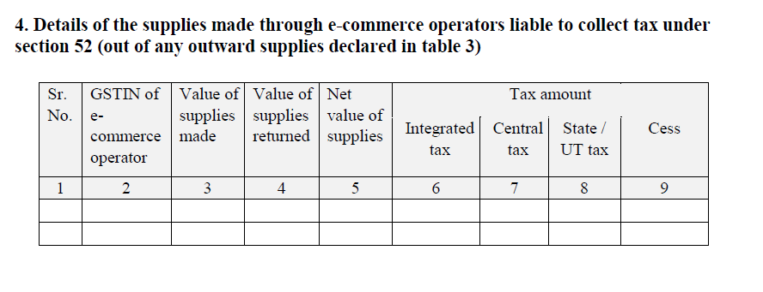
This table does not create liability. All E-commerce transactions which are already covered in table 3 should be shown here separately.

Slide 22
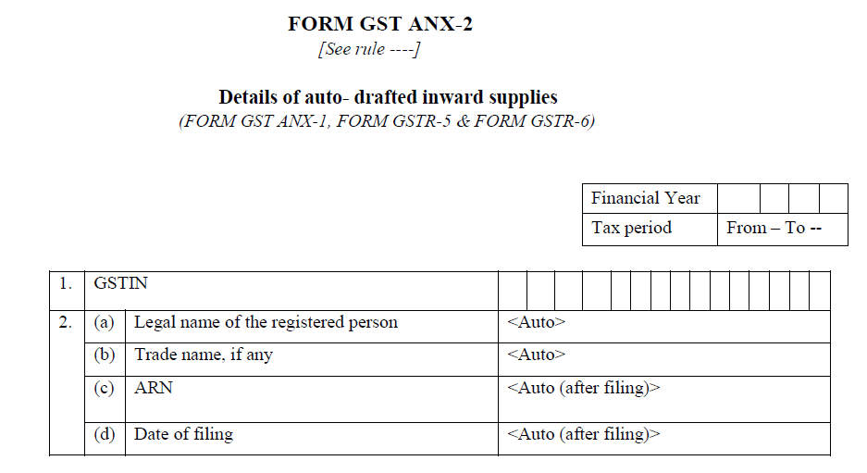

Slide 23
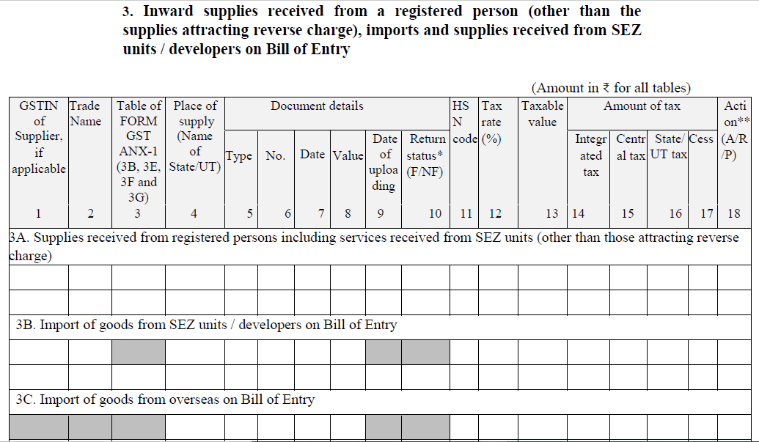

Slide 24
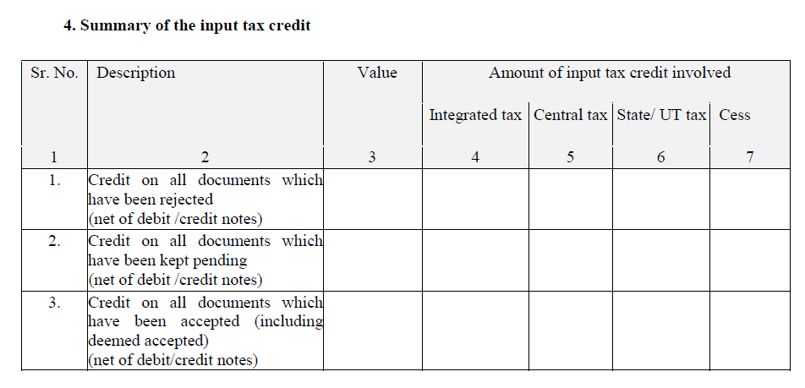

Slide 25
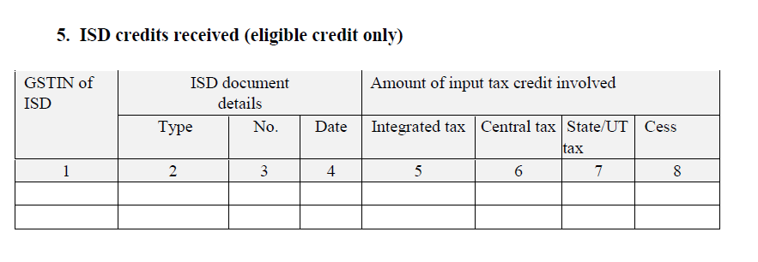

Slide 26
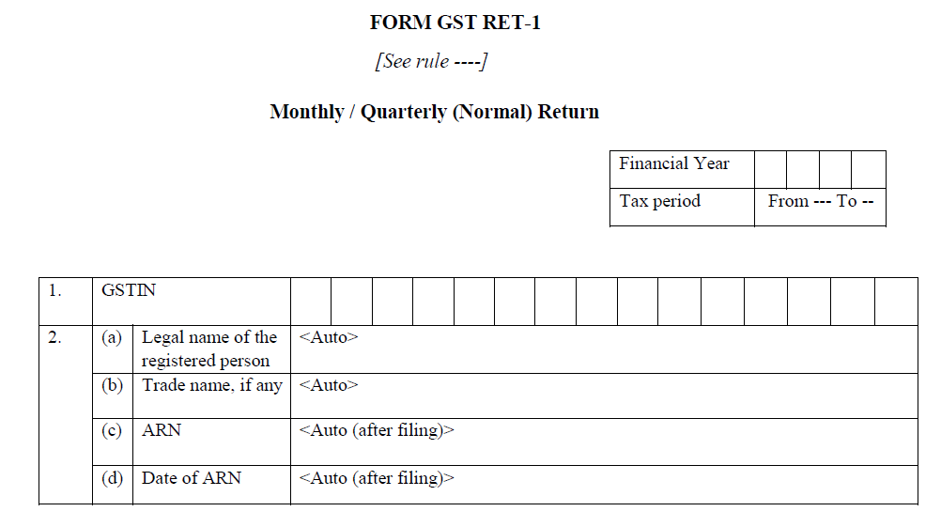

Slide 27
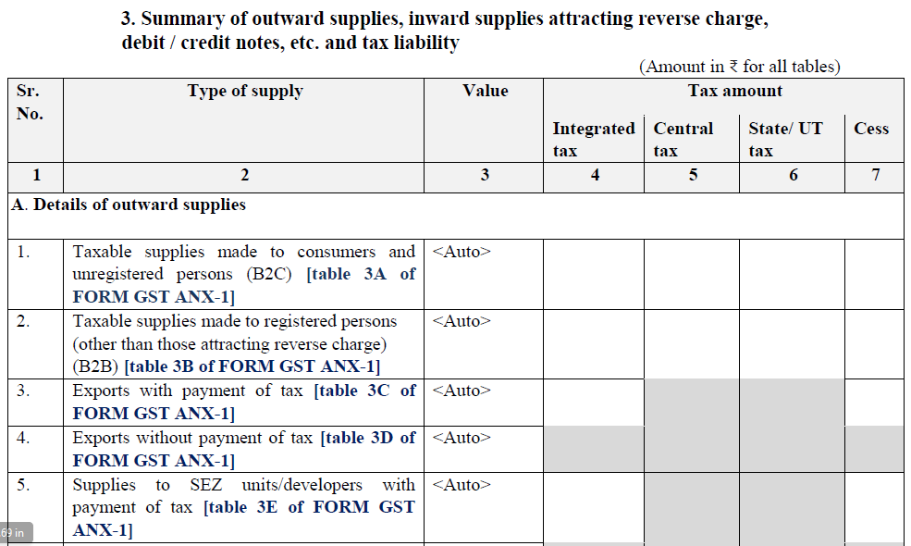

Slide 28
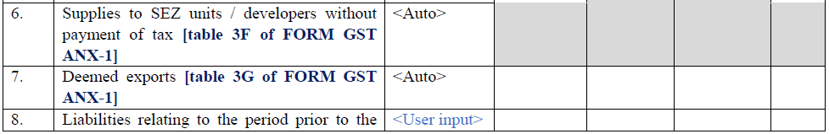
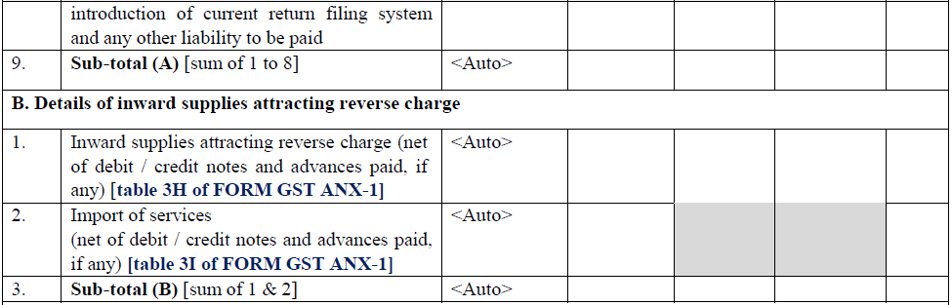

Slide 29
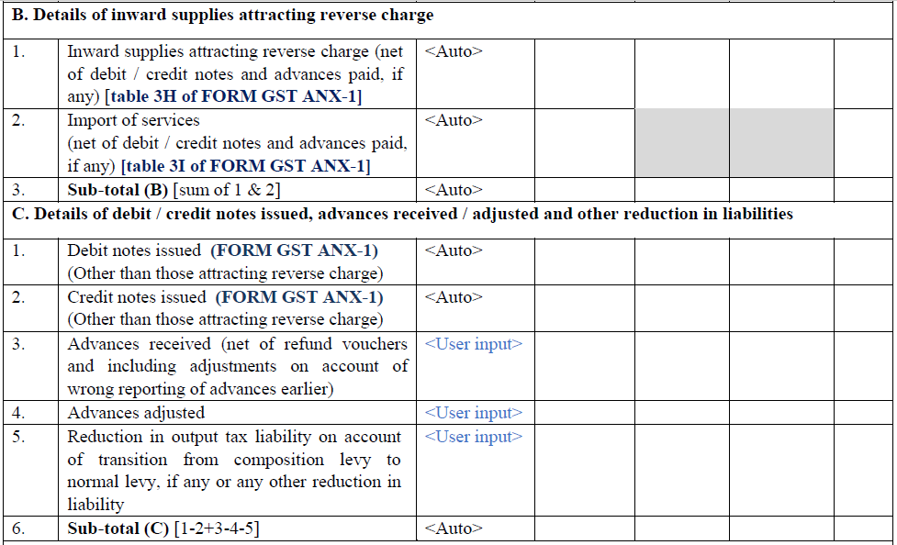

Slide 30
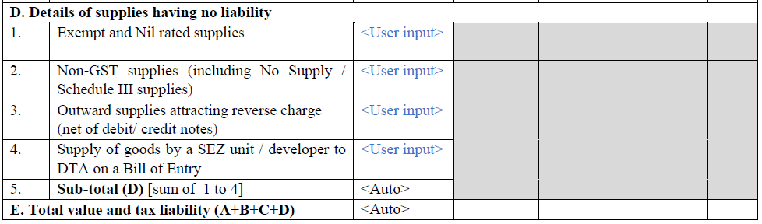

Slide 31
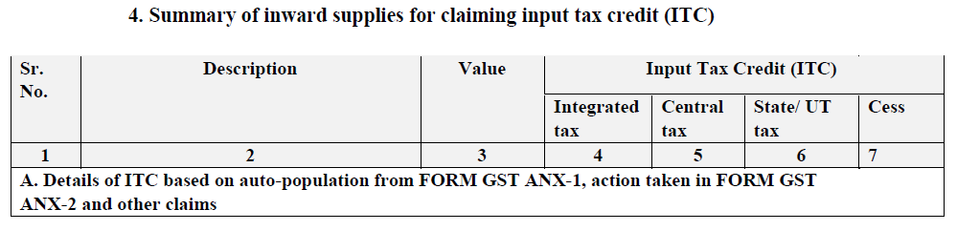
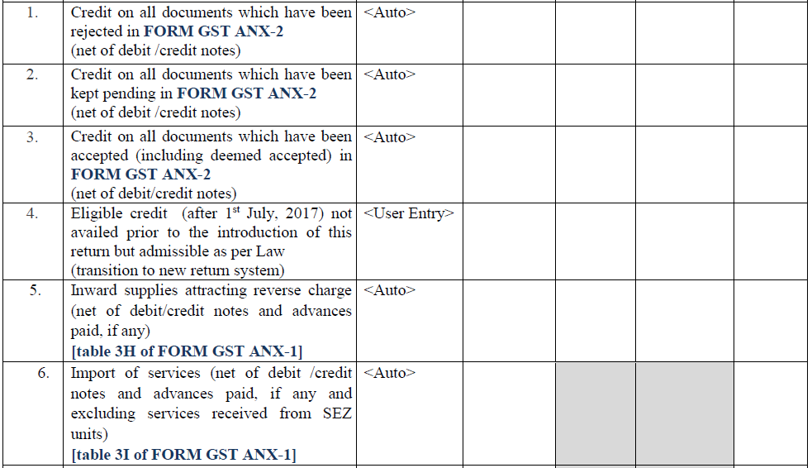

Slide 32
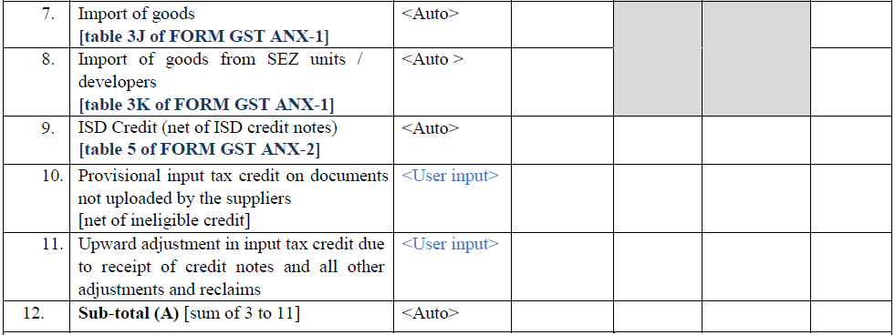

Slide 33
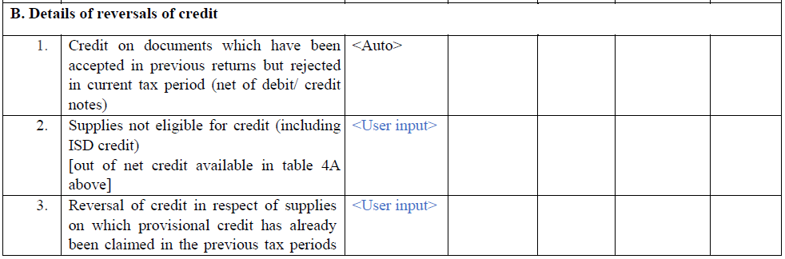
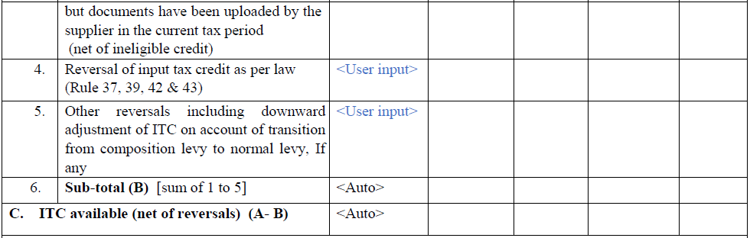

Slide 34
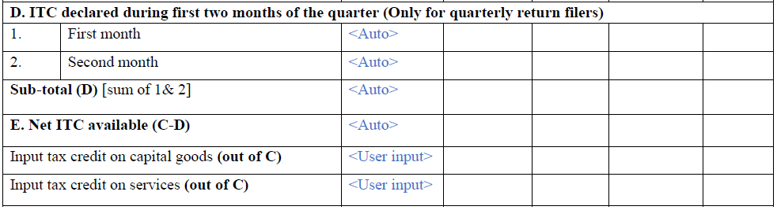

Slide 35
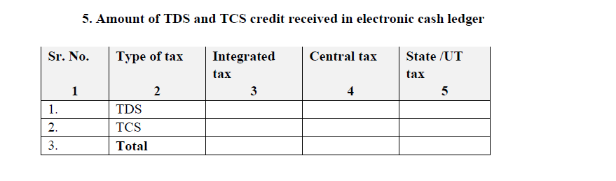

Slide 36
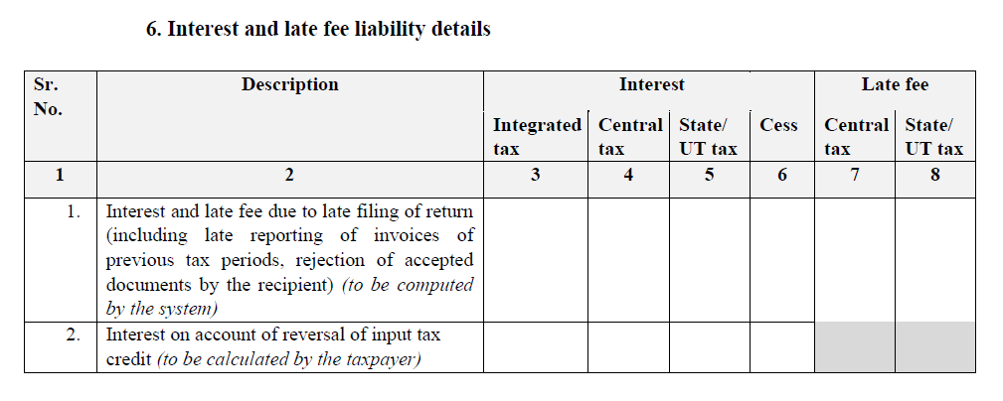
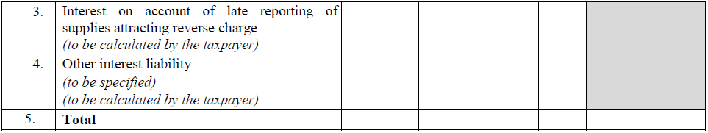

Slide 37
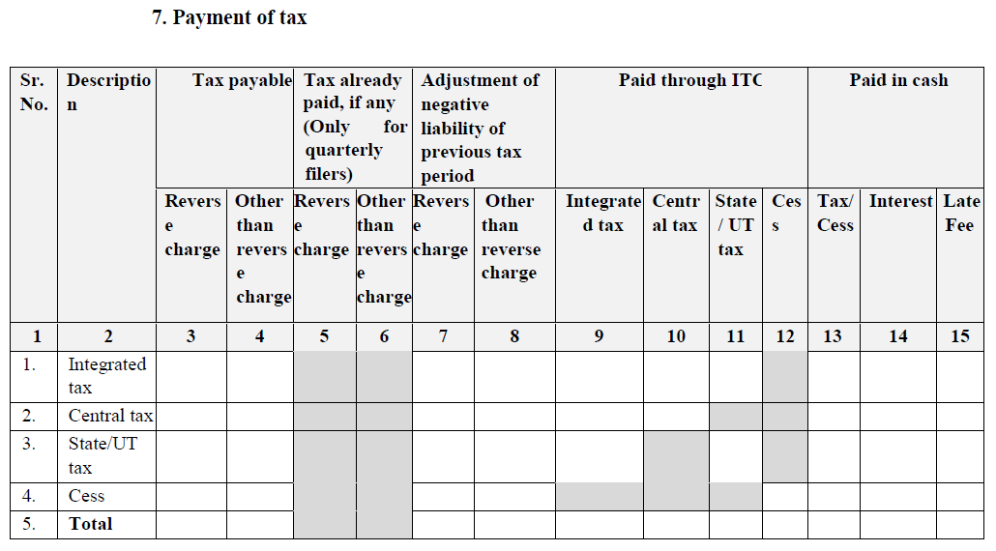

Slide 38
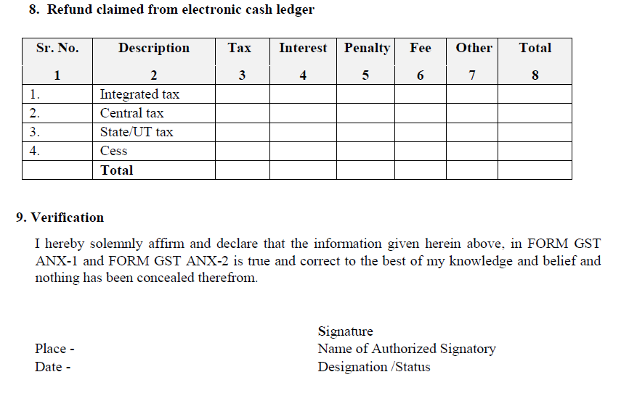

Slide 39
Amendments through ANX-1A
3A – B2C Supplies.
3C – Exports with payment of tax.
3D – Exports without payment of tax.
3H – Inward supplies liable under RCM.
3I – Import of Services.
3J – Import of goods.
3K – Imports from SEZ.
Will generate RET -1A and liability to be discharged. Even negative liability possible.

Slide 40
Amendments through RET-1
3B – B2B Supplies.
3E – Supplies to SEZ with payment of tax.
3F – Supplies to SEZ without payment of tax.
3G – Deemed Exports.
All amendments which have a bearing on recipient to be amended through RET-1 and not through ANX-1A.

Slide 41
RET-2 - SAHAJ
NewGSTReturn_Sahaj.pdf

Slide 42
RET- 3 - SUGAM
NewGSTReturn_Sugam.pdf

Slide 43
THANK YOU mail@swamyassociates.com

